Slide 1
Wrangle Data
CS 3270 — Chapter 12

Slide 2
Agenda
Regular Expressions
Binary Data

Slide 3
Wildcards
Used on the command line in most operating systems
$ ls *.py KiteOnboarding.py stream_output.py
$ ls banner?.png
banner4.png banner5.png
* means 0 or more characters (different than with regular expressions)
? Matches 0 or 1 characters
Can use for string matching with the fnmatch module
Functions: fnmatch, fnmatchcase

Slide 4
Using fnmatch From Python Cookbook
addresses = [
'5412 N CLARK ST', '1060 W ADDISON ST', '1039 W GRANVILLE AVE',
'2122 N CLARK ST', '4802 N BROADWAY',
]
from fnmatch import fnmatch
print([addr for addr in addresses if fnmatch(addr, '* ST')])
print([addr for addr in addresses if fnmatch(addr, '54[0-9][0-9] *CLARK*')])
''' Output:
['5412 N CLARK ST', '1060 W ADDISON ST', '2122 N CLARK ST']
['5412 N CLARK ST']
'''

Slide 5
Raw Strings
Regular Expressions are a widely used, powerful, pattern-matching facility
Patterns are often written as raw strings:
for brevity
so you don’t have to type \\ for escape characters
>>> len('\n')
1
>>> len(r'\n')
2

Slide 6
re Functions
search(pattern, string) # Looks for match anywhere in string
match(pattern, string) # Looks for match at start of string
fullmatch(pattern, string) # Entire string must match
findall(pattern, string) # Extracts strings of interest as a list
words = re.findall("[a-zA-Z']+", text)
finditer # Similar to findall, but returns an iterator
split(pattern, string) # Splits on matches for string
sub(pattern, repl, string) # Replaces matches with repl

Slide 7
Special Characters
. Matches any char (not ‘\n’)
^ Start of string
$ End of string
* 0 or more repetitions (suffix)
+ 1 or more repetitions (suffix)
? 0 or 1 occurrences (suffix)
{m} m repetitions (suffix)
{m,} m or more
{m,n} m-to-n repetitions (max)
[…] match chars in set
[^…] match chars not in set
A | B match A or B
See re1.py, re2.py

Slide 8
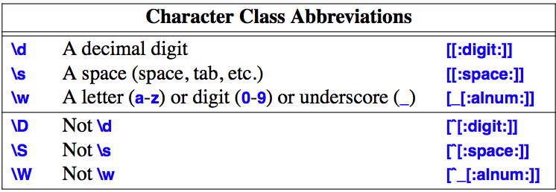
From Stroustrup, Tour of C++, 2nd Ed.

Slide 9
More Special Characters
\b Match a word boundary
\d Match a decimal digit [0-9]
\s Match whitespace
\w match alphanumeric or _
\B Match a non-word boundary
\D Match non-digit [^0-9]
\S Match non-whitespace
\W Match non-alphanumeric|_

Slide 10
Word Boundaries
>>> s = "the then writhe *the* xthex"
>>> re.findall('the',s)
['the', 'the', 'the', 'the', 'the']
>>> re.findall(r'\bthe',s)
['the', 'the', 'the']
>>> re.findall(r'\bthe\b',s)
['the', 'the']
>>> re.findall(r'\Bthe',s)
['the', 'the']
>>> re.findall(r'\Bthe\B',s)
['the']
Where did each of these come from?

Slide 11
Whitespace, alphanumeric, _
>>> s = "abc123 456def m_field $10 $20.3"
>>> re.findall(r'\w+',s)
['abc123', '456def', 'm_field', '10', '20', '3']
>>> re.findall(r'\W+',s)
[' ', ' ', ' $', ' $', '.']
>>> re.findall(r'\S+',s)
['abc123', '456def', 'm_field', '$10', '$20.3']
>>> re.findall(r'\d+',s)
['123', '456', '10', '20', '3']
>>> re.findall(r'\D+',s)
['abc', ' ', 'def m_field $', ' $', '.']

Slide 12
Groups
Formed by using parentheses around a regular expressions
Can be retrieved by position number or name
>>> m = re.search(‘(\w\w\w)-(\d\d\d)','abc-123')
>>> m.group() # Same as m.group(0)
'abc-123' # Entire match
>>> m.group(1)
'abc'
>>> m.group(2)
'123'
>>> m.group(2,1) # Subscripts
('123', 'abc')
>>> m.groups()
('abc', '123')

Slide 13
Subgroups
Nested groups
>>> m = re.search('(a(b))','ab')
>>> m.group()
'ab'
>>> m.group(1)
'ab'
>>> m.group(2)
'b'
>>> m.groups()
('ab', 'b')

Slide 14
Idioms
.* Matches anything, including the empty string
.+ Matches any non-empty string
See resample1.py, resample2.py

Slide 15
Replacing Strings From Python Cookbook
>>> text = 'Today is 11/27/2012. PyCon starts 3/13/2013.’
>>> import re
>>> datepat = re.compile(r'(\d+)/(\d+)/(\d+)’)
>>> datepat.sub(r'\3-\1-\2', text)
'Today is 2012-11-27. PyCon starts 2013-3-13.'
If you use the same pattern repeatedly, compile it first.
Changes Date formats

Slide 16
Binary Data
Bytes
Bytearray
struct

Slide 17
bytes
An immutable byte sequence
Returned from str.encode, int.to_bytes
>>> n = 5
>>> b = n.to_bytes(2, 'little')
>>> b
b'\x05\x00'
>>> int.from_bytes(b, 'little')
5
>>> int.from_bytes(b, 'big')
1280

Slide 18
bytearray
A mutable sequence of bytes
In addition to decode, has many familiar methods:
count, find, index, join, rfind, split, …
Often used to store binary data
You can pack and unpack data to and from byte arrays
Using the struct module
(Helpful for CS 4380’s VM/assembler!)
>>> blist = [1, 2, 3, 255] >>> the_byte_array = bytearray(blist)
>>> the_byte_array
bytearray(b'\x01\x02\x03\xff') >>> the_byte_array[1] = 127 >>> the_byte_array
bytearray(b'\x01\x7f\x03\xff')

Slide 19
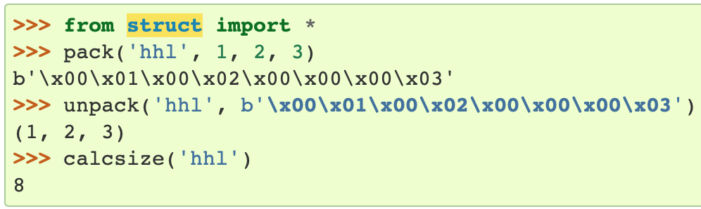
The struct Module
Allows packing/unpacking data into/from a bytearray
Invented for interfacing with C
Used to control the byte layout of data in a memory buffer
little endian
>>> pack(‘<hhi', 1,2,3)
b'\x01\x00\x02\x00\x03\x00\x00\x00'
big endian
Notes:
The endian-ness defaults to the machine architecture. The example above from the Python Doc is big endian.

Slide 20
Struct Methods and Formats
Methods:
pack
pack_into
unpack
unpack_from
? bool
b/B byte
h/H short int (2 bytes)
i/I int (4 bytes)
l/L (same as int; l == ‘ell’)
q/Q long long (8 bytes)
f 32-bit float
d 64-bit float
Format codes. Lowercase means signed, uppercase is unsigned.

Slide 21
Packing/Unpacking Strings The s Format Specifier
Must use an encoded string
Preceded by the number of bytes in the the string
10s means that there are 10 bytes in the string
Numbers can precede other formats as well
But it is a repetition factor there
5i == 5 signed integers
See struct0.py, struct1.py

Slide 22
The p Format
The p specifier stores the number of used bytes as the first byte
So only count-1 bytes from the encoded string are stored
And the number can’t exceed 255 (254 actual bytes from the string)
Preferred for fixed-length byte storage
See struct2.py

Slide 23
memoryview
A view into raw storage
Like bytes, bytearray, array.array
No copies are made when slicing (like numpy.ndarray)
Allows assigning bytes so you don’t have pack explicitly
Similar to reinterpret_cast or unions in C++
See mview.py

